Slide 1
Unit 6 Vocabulary: Weather and Climate
Directions. IN THE GLOSSARY OF YOUR NOTESBOOK: Number, underline, and separate words and definitions. Look up, research, and write a complete, scientific definition for the following words.
Weather
Climate
Latitude
Longitude
Elevation
Windward
Leeward
Prevailing Winds
Cold front
Warm front
Dew point
Humidity
Rain shadow
Heat capacity
Lake-effect snow
Global climate
Little ice age
Paleoclimate
Climate proxy
Isotope
Dendrochronology
Xylem
Phloem
Pollen

Slide 2
Factors influencing climate

Slide 3
Terminology…
1. Weather is defined as…
The condition of the atmosphere at a particular place at a particular time.
2. What is the atmosphere?
It is the layer of gases that surrounds the earth, forming a protective barrier between the earth and space.
3. It is because of our atmosphere that there are conditions suitable for life.

Slide 4
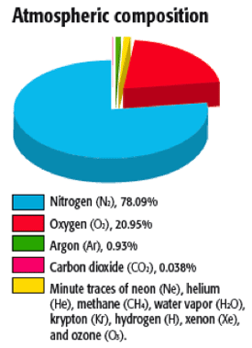
Atmospheric composition
In total, the atmosphere…
is composed of the elements nitrogen (78%), oxygen (21%), water vapor (0.02 – 4% what we hear of as humidity), and other gases such as carbon dioxide, methane, and several noble gases.

Slide 5
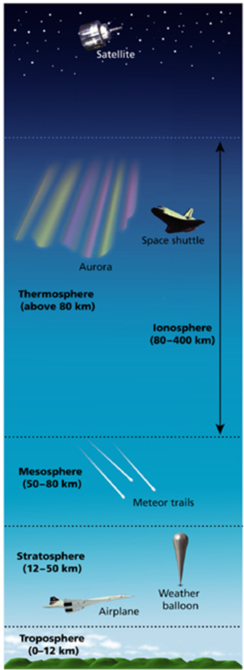
4. Layers of the atmosphere
exosphere
Our atmosphere is distributed over 4 distinct layers.
We live in the first layer, called the troposphere that extends upward about 12km
From 12km up to 50 km above that is the stratosphere.
The Ozone (0₃) layer is contained within the stratosphere.
Above that, from 50-80km is the mesosphere.
The thermosphere is above that, from about 80km to outer space.
Somewhat overlapping the thermosphere is the ionosphere, which is a region of charged particles responsible for auroras.
Outer space is referred to as the exosphere.
ionosphere
thermosphere
mesosphere
stratosphere
TROPOSPHERE

Slide 6
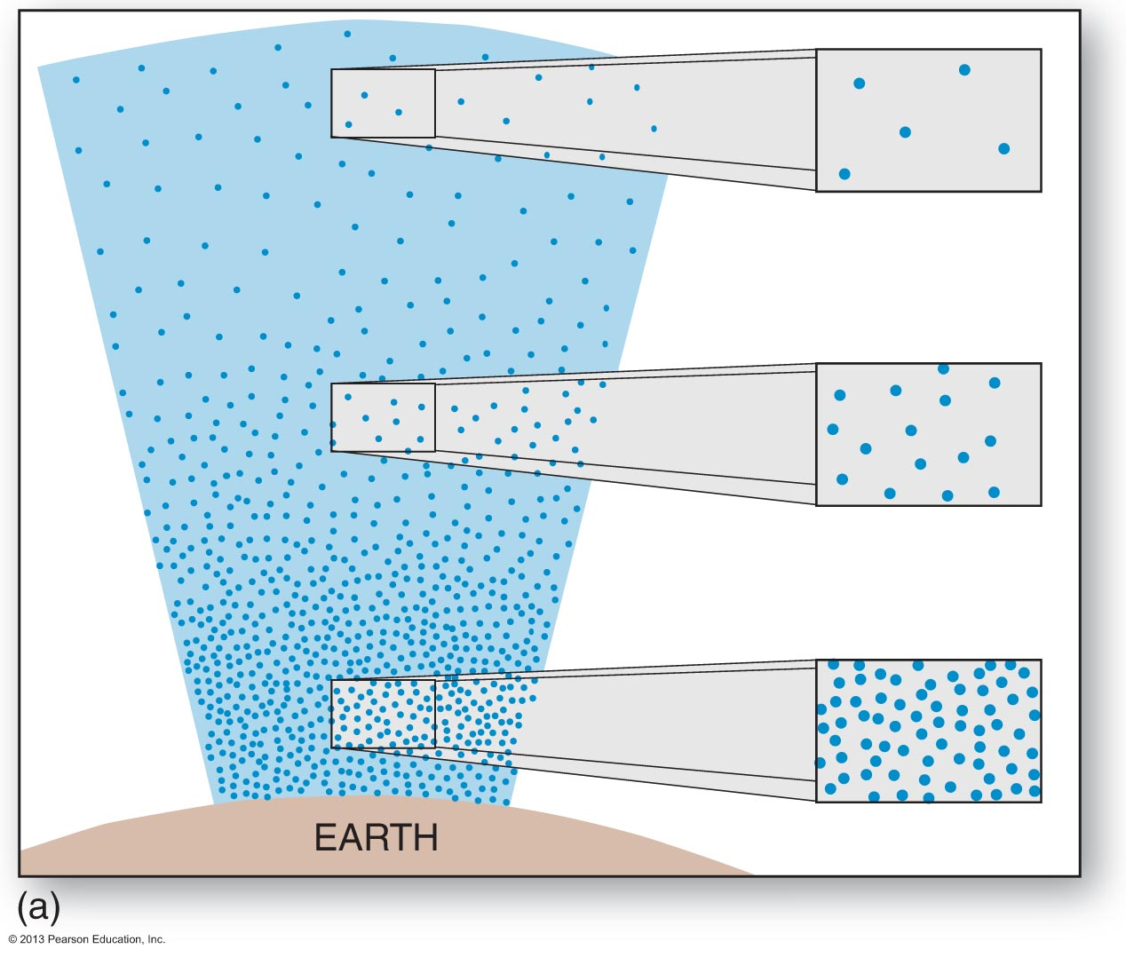
Characteristics of the atmosphere
The atmosphere is Not 100% consistent throughout.
Gravity pulls Air molecules downward and as they stack on top of each other create more and more air pressure.
Imagine these molecules dogpiling on top of each other.
Air pressure is calculated by using a barometer.
The unit for pressure is usually either mmHg, bars, or Pa.
Because of the differences in the particles that make up the atmosphere and gravity… 4. air density and air pressure decreases as you go higher up.
HIGH pressure LOW

Slide 7
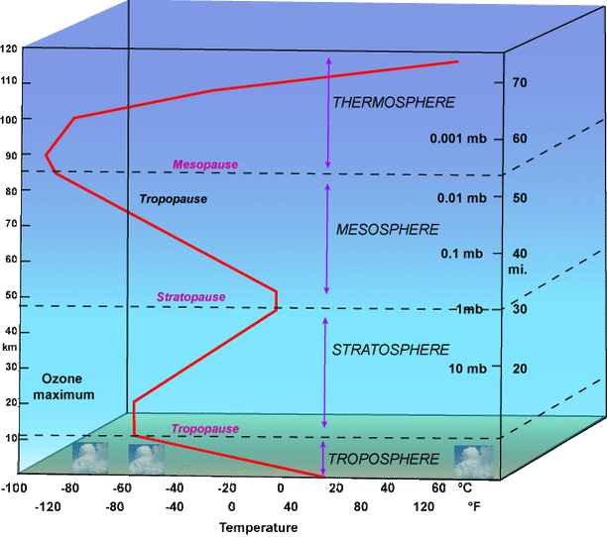
Atmospheric Temperatures
At 120km, the temperature is over 150°F! WHY???
Which do you think is more likely to happen to you if you we in a hot air balloon 120km above the earth? (granted you can breath)…
Would you freeze to death or burn up?
It does get very cold in the atmosphere, but BECAUSE OF THE LOW DENSITY AND LESS PROTECTION FROM THE SUN, THERE ARE A WIDE RANGE OF TEMPERATURES IN THE ATMOSPHERE.

Slide 8
Weather in the Troposphere
The entire atmosphere as a unit is vitally important and distinct things happen in different pressure regions but we only inhabit one of the layers… the troposphere.
we’re focusing on the weather and climate in the troposphere since it’s where we live and since this is where most of the weather happens.

Slide 9
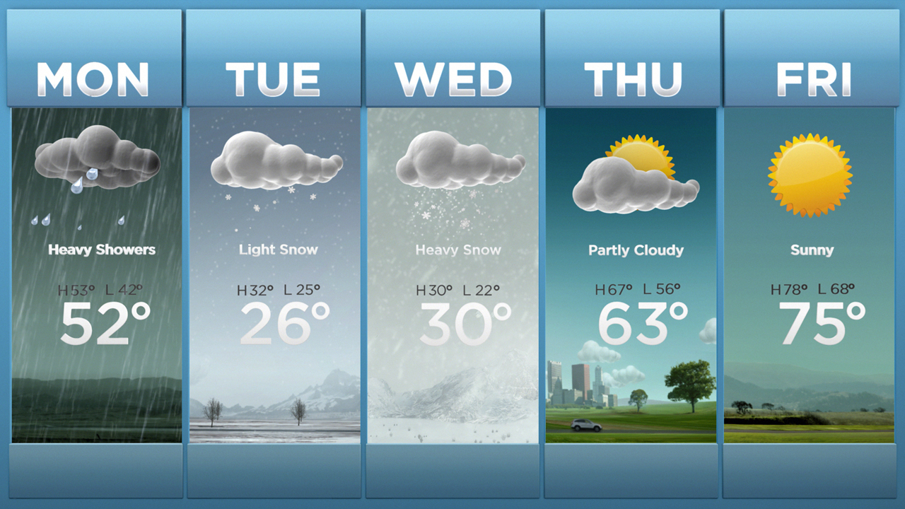
Look Familiar?
Basic atmospheric conditions…
Condition of the clouds and sun…
Quantity of precipitation…
Temperature…
The main focus of your learning will be on why different regions of Earth, which we refer to as ecosystems, experience different weather. There are a few FACTORS that you need to know.

Slide 10
Factors Influencing Climate
there are two main factors determining climate; temperature and precipitation.
Essentially, a climate is dependent upon the temperatures it exits in and the amount of rain it receives.
Now, let’s take a closer look at what affects these two…
The factors that affect temperature…
Latitude
Location
Altitude
Currents
The factors that affect precipitation…
Latitude
Location

Slide 11
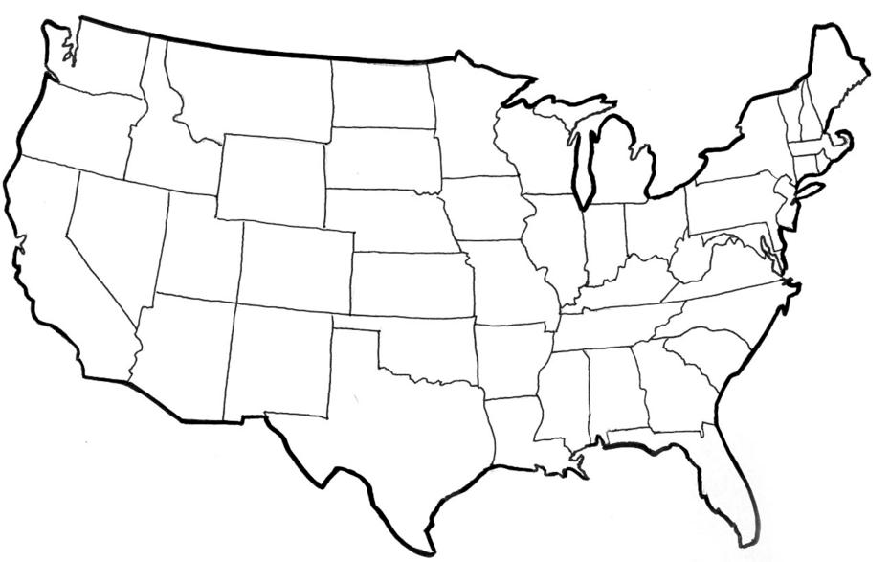
Conclusions?
COLDER
Duluth
MORE CONSTANT TEMPERATURES
DRIER
San Francisco
Washington, D.C.
RAINIER
Denver
LARGER TEMPERATURE FLUCTUATIONS
Kansas City
RAINIER
Phoenix
MORE CONSTANT TEMPERATURES
WARMER
Miami

Slide 12
Temperatures

Slide 13
Factors Affecting Temperature
Globally, the average temperature for the earth is roughly 60 degrees Fahrenheit, but this fluctuates tremendously based upon where you are taking the measurements.
For starters…
136°F was the hottest ever recorded
(Death Valley & El Azizia (north Africa))
-136°F (coincidentally) was the coldest
(Antarctica)
But each day temperatures fluctuate within ranges and these are quite different depending on where you are…

Slide 14
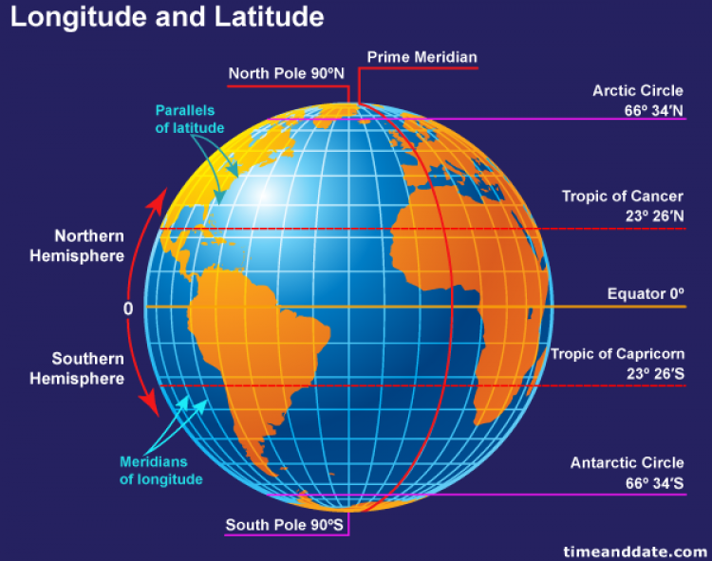
Latitude’s effect on temperature
Location obviously affects temperature.
Longitude: is a east-west measurement that does not affect temperature directly.
Latitude: is the distance from the equator.
The farther you move NORTH AND SOUTH from the equator the colder it is on average because the amount of direct sunlight energy decreases.

Slide 15
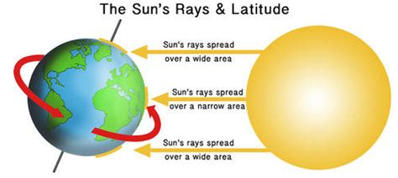
In case this doesn’t make sense…

Slide 16
location’s effect on temperature
Location: where exactly is the region of interest with respect to its proximity to…
Near The center of land masses
Tend to have wider ranges of temperature between seasons as well as day & night.
Near Large bodies of water
Tend to have milder temperatures within a smaller range during different seasons and day & night
Proximity to Mountain ranges
Mountains cause rapid changes in altitude, which affects temperatures and pressure.

Slide 17
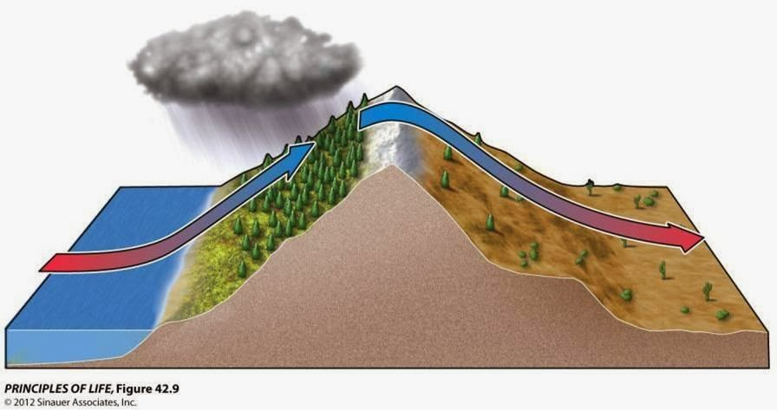
location’s affect on temperature
Mountain ranges: Regions
Windward side: the side facing the body of water.
Leeward: the side facing away from the water.
Windward
Side
Leeward
Side

Slide 18
current’s affect on temperature
Currents are naturally created because of the changes in temperature and pressure in different regions.
KEEP IN MIND: COLDER AIR IS PULLED TOWARD WARMER AIR
Because of the rotation of the earth and the nature of temperature distribution, air and water are being heated and cooled at different times causing a constant churning of air and water.
These affect temperatures around the globe.
There are two main currents we are concerned about
The affect of Ocean currents
The affect of Wind currents

Slide 19
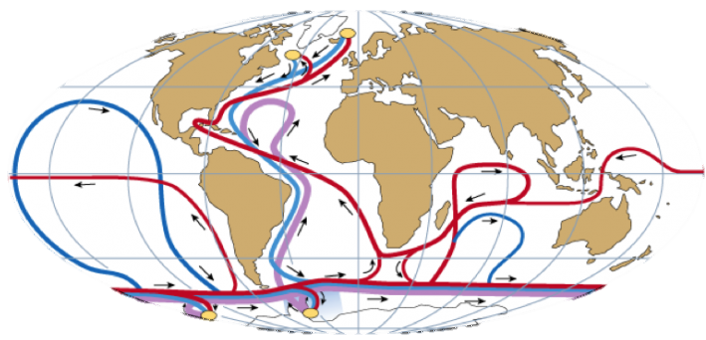
Ocean Currents
There are two important considerations when looking at the differences in the temperatures around the earth SINCE water FLOWS ALSO affect temperatures.
Water takes longer to change temperature than land (high heat capacity)
Warm rises (AND EXPANDS) and cold drops (AND CONTRACTS).
This creates the ocean currents that help churn uneven temperatures.

Slide 20
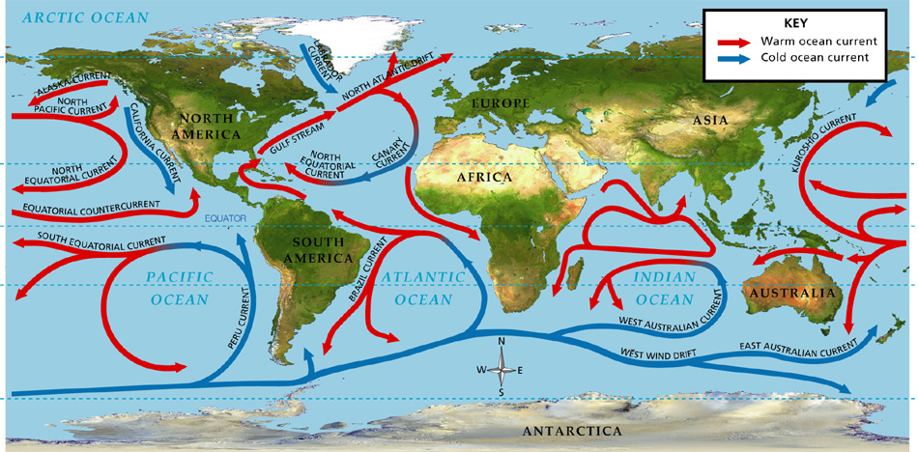

Slide 21
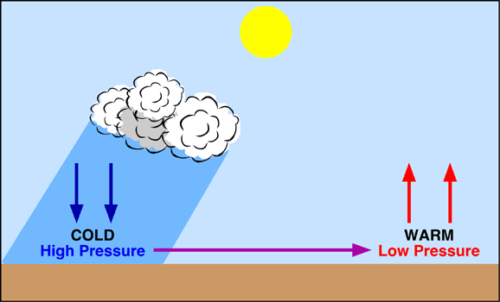
The Effect of wind
Wind is the horizontal movement of air.
Wind is caused by differences in air pressure.
Higher temperatures produces air expansion and lower pressure, causing air molecules to expand and become less dense.
Cold is the opposite
IN GENERAL, AIR TRAVELS AS WIND FROM COOLER, HIGH DENSITY AND PRESSURE REGIONS TO WARMER, LOW DENSITY AND PRESSURE REGIONS.
WIND

Slide 22
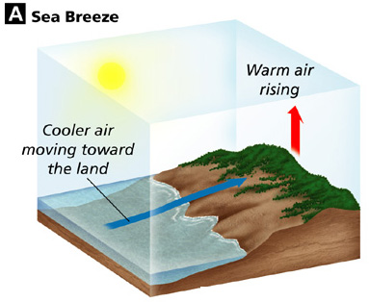
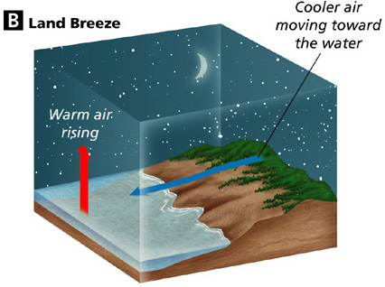
Wind’s affect on temperature
Land heats faster than water, which creates…
Sea breeze: When the WARMER air above the land expands, it sucks cooler air FROM the nearby water into land.
Land Breeze: When the sun sets, the land cools faster than the sea so the air gets sucked back out to the warmer sea.

Slide 23
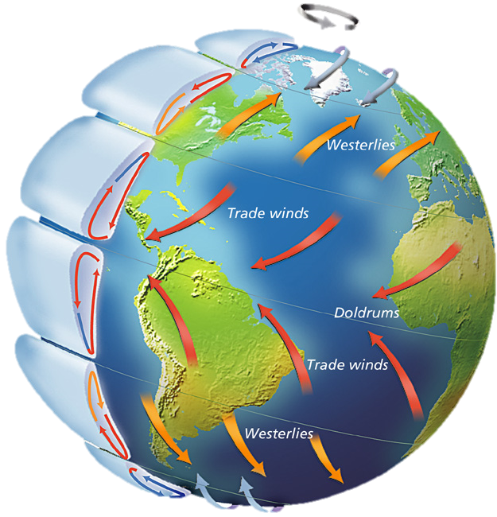
Global Winds
Study the figure at the right. Notice the different belts of global winds on Earth’s surface.
Why do you think that the global winds curve?
If a rocket left Earth at the North Pole, what direction would it travel over Earth’s surface as it approached the Equator?

Slide 24
Prevailing Winds
prevailing winds (also called Global winds) are those that consistently blow over long distances in a specific direction.
Caused by the unequal heating and cooling and the Coriolis effect.
The Coriolis effect: the curving effect that the Earth’s rotation has on all free-moving objects (not on the ground).
The Coriolis effect combined with differences in pressures contributes to the consistency of the prevailing winds.

Slide 25
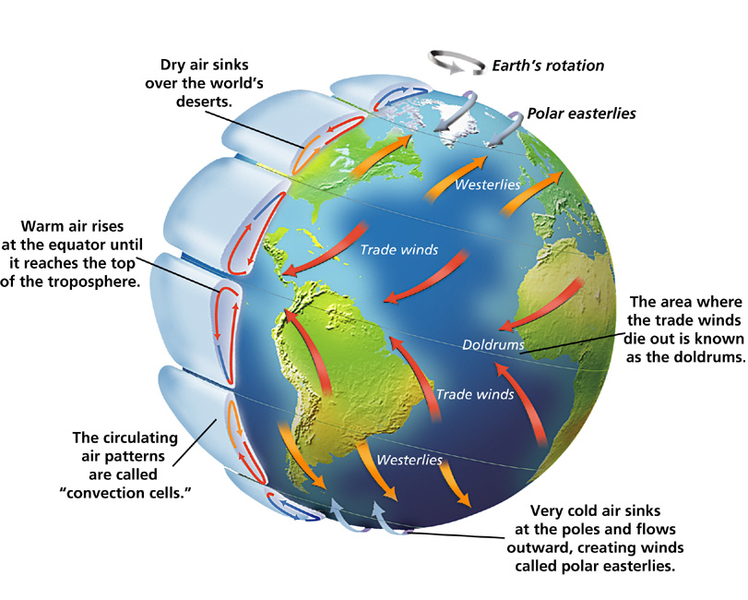

Slide 26
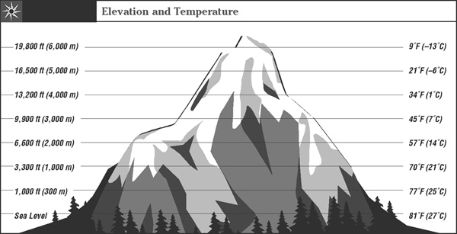
altitude’s affect on temperature
Altitude: the height above an object, usually sea level.
ELEVATION is always in reference to sea level
AS WE INCREASE ALTITUDE THROUGH THE Troposphere, temperature decreases because of lower air pressure.

Slide 27
Precipitation

Slide 28
Latitude’s effect on precipitation
Precipitation is water falling back to Earth in the form of rain, fog, sleet, or snow.
Latitude: the distance from the equator.
In general, Low pressure areas exist at the 0° and 60°North and South generally produce heavy precipitation.

Slide 29
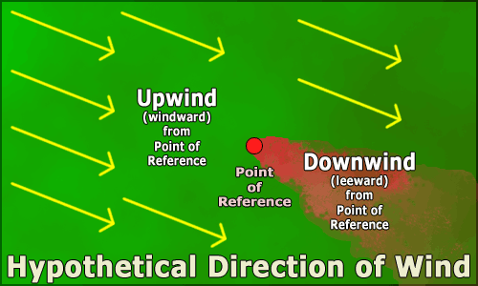
location’s effect on precipitation
One of the most important affects on precipitation is location.
Locations near the center of a large land mass tend to have drier climates.
Locations near large bodies of water tend to have higher than average precipitation, especially on the leeward (downwind) side of a body of water.

Slide 30
location’s effect on Precipitation
Mountain ranges influence Precipitation as well.
See breezes push cooler Moist air upward, increasing pressure as it rises causing condensation of cooler water vapor and more rain on the windward side, but also drought on the leeward side.
Rain Shadow: a dry area on the leeward side of a mountainous area
RAIN SHOWER
Leeward
Side
Windward
Side
RAIN SHADOW

Slide 31
Latitude’s affect on precipitation
Latitude: the distance from the equator.
There are so many variables at this point there is little consistency with regard to how far east or west you travel!

Slide 32
Conclusion
In general, keep in mind
Heat causes expansion (because atoms have more energy and move away from each other more) and decreases pressure
Cold causes contraction (because atoms have less energy, slow down, and get closer to each other) and increases pressure
Cold tends to move toward hot because…
Low pressure moves toward high pressure
Water tends to hold its temperature better than ground so the farther you move from it the more changes there will be and the more extreme they will be.
You have learned some very important factors that affect climate too.
Temperature and precipitation are the two most important factors determining climate.
Temperature is largely determined by the proximity to water, elevation, and latitude.
Precipitation is largely due to proximity, or nearness to water.

